Slide 1
Intro to APIs
GDI Boise

Slide 2

Client Side APIs
What
Why
How

Slide 3
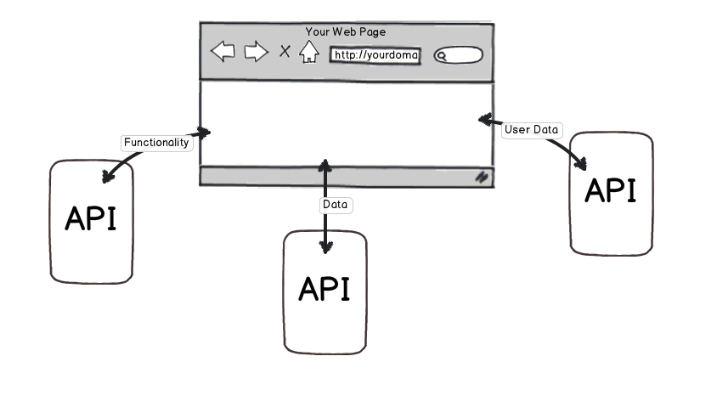
What is a web API?
Application Programming Interface
Notes:
Your Internet experience runs on APIs. The acronym has helped you compare the best prices for flights, allowed you to embed a map into your store’s website and seamlessly processed your credit card payments.
But what is an API and why does it matter to you?
API stands for application programming interface. It’s a concept and an intangible item. APIs operate on an agreement of inputs and outputs.
Application: These can be apps that you use on your smartphone or a software program that you use. Programming: Developers use APIs to write software. Interface: How you interact with the application.
To use an analogy here, we’ll compare this to ordering a drink at a bar. When you step up to the bar, you’re given a menu with several drinks listed. There’s an agreement here or the concept of the API, where you’ll order a drink and be served a drink.
The menu as it’s presented to you is the interface. All the drinks listed on the menu are what the bartender has agreed to serve. When you ask for a certain drink on the menu, you receive it. But if you ask for something off the menu, such as a vodka martini instead of a gin martini, the bartender will tell you no because it’s not something they agreed to serve.
Let’s say you want the martini delivered to your home. You call a delivery service and you order a martini. When you order it, someone will tell the bartender your order, the bartender will make the martini and then someone will deliver it to your home. This is an example of an service built on an “API” (the menu).

Slide 4
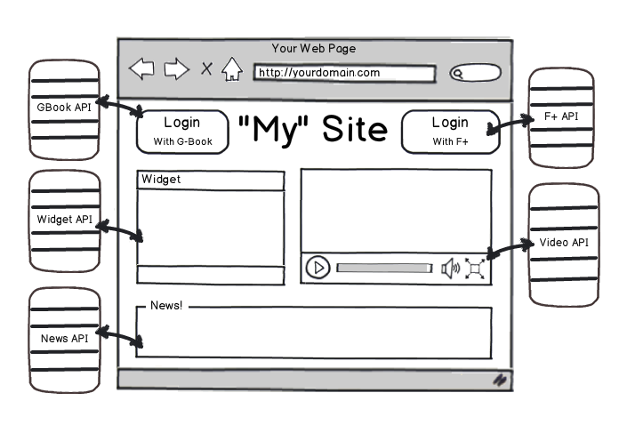
Why: Client Side APIs
Notes:
There are Multiple Types of APIs
Public APIs are released by companies like Slack and Shopify in hopes that developers will use them to build on their platforms. The company will share a set of inputs that you can use to achieve certain outputs. For every input, they agree to give an output and the output does not differ.
You don’t need to submit your app for approval for a public API. They’re usually documented and can be accessed without too much fanfare.
Private APIs are used internally at a company. If a company has multiple software products, private APIs are used for the software to “talk” to each other. The components of the APIs can change at the company’s whim, whereas a change to a public API would cause an outcry.
Why are APIs Important for You?
As we mentioned earlier, your Internet experience runs on APIs. Instead of accessing four different companies four separate times, you may use one software to access all four at the same time.
APIs Streamline Your Processes
The Sprout Social Smart Inbox is an excellent example of this. Before, you would log into Facebook and Twitter separately, check messages, run search terms and respond when you were tagged. Now, thanks to the networks’ APIs, you can see it all in one view, cutting out on extra time.
Apps Make Your Life Easier
If you use public transit, you likely have an app telling you when the next bus is arriving. The app uses the transit’s API to show which bus is arriving and when. It saves you time and possibly from freezing if you live in a cold climate.
Businesses Expand with APIs
A business’ potential can be expanded when they offer an API. There are only so many resources a business can offer. Having an API available, with developers who are eager to build on them, can expand their offerings to more people.
A good example is a software like Mint that can connect with multiple banks and compile it in one area. A bank’s core offering is storing your money and recording your credit card expenses. The bank allows Mint to connect to its API, so you can better manage your money and consequently, continue being a customer at the bank.
5 Things You Should Know About APIs
To recap, here are the five takeaways for APIs.
Developers work with APIs to create software and apps. It’s rare for you, the end user, to directly interact with an API.
APIs operate as a gate, allowing companies to share select information but also keeping unwanted requests out.
APIs can make your life run a little smoother. When airlines share data about flights and prices, travel aggregating sites can compile them all and help you compare.
Businesses are built on APIs. Sprout Social itself is an example of a software that is built on the APIs of social media networks.
If you’re using a third-party app to manage your social media, it might not be the app’s fault that a feature isn’t being offered. It’s more likely that the network doesn’t have it as part of their API.

Slide 5
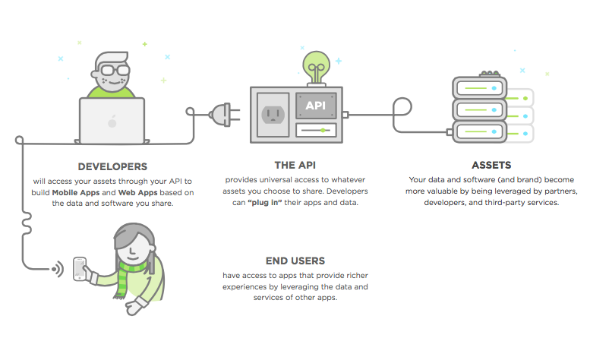
Client Side APIs: HOW
Notes:
An API acts like a doorway to your server and database that those with an API key (or a paid subscription) can use to access whatever assets you choose to reveal. A key could give a user read access, write access, or both—it’s up to you.

Slide 6
Exercise One: HTML APIs
In this exercise, you'll try out using several HTML APIs to add more dynamic content to the starter webpage.
Open the ExerciseOneStarter.html file. Open the webpage up in the browser and make sure it works. It should pull in video information from inline JSON data and display linked video thumbnails in a list.
Add a counter: Go to flagcounter.com and set up a hit counter for your website. Put the counter somewhere near the bottom of the page within a div using id=“counter”.

Slide 7
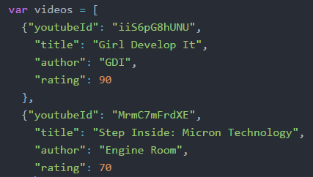

Rating Chart
Step 1: Add a "rating" field to each video in the inline JSON data.
Step 2: Go to the Google Gauge Charts API Docs and read about the Gauge Chart API parameters.
Step 3: Open the link to the JSFiddle example and notice the HTML portion is segregated from the JavaScript portion.

Slide 8
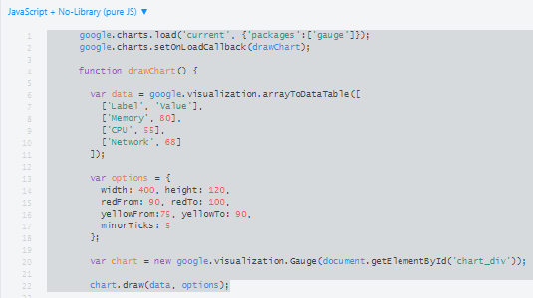
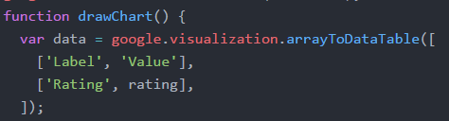
Add Rating Chart Continued…
Step 4: From the top of the JavaScript portion, copy the contents until you reach the setInterval function (lines 1-22).
Step 5: Rename the section titled “Memory” to “Rating”
and delete CPU and Network.
Step 6: Add the loader.js script to the header of the webpage and the chart div to the body of the webpage.

Slide 9
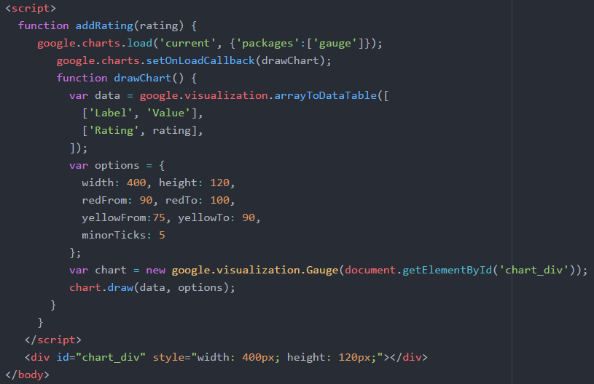
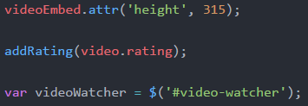
Add Rating Chart Continued…
Step 7: Add a script section to the body of the webpage and nest the JavaScript code within a function called addRating that accepts a variable called “rating” and assigns this variable to the rating field.
Step 8: Call the addRating function within the addVideoToList function.
Step 9: Save and test the web page. Click on the videos to test the new gauge chart. If it isn’t working open the console to check for errors.

Slide 10
Astronomy Picture of the Day
Visit NASA’s popular site at: https://api.nasa.gov/api.html#apod
This site loads in a different picture or video every day and provides an API for those who would like to retrieve the picture and associated information.
Sign up for an API key.
Open the apodStarter.html file in an editor.

Slide 11
Exercise Two: APOD
Replace the DEMO_KEY with your key.
Refresh the page and ensure it works.
Check console for errors if it isn’t working.
Change the date and refresh the page. Notice the picture and information change.

Slide 12
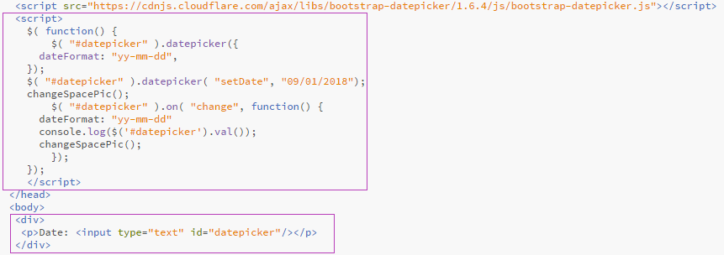
Exercise Two: APOD
In the header add the datepicker function.
In the body add a div, a paragraph and an input for datepicker.

Slide 13
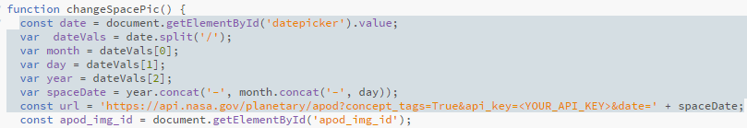
Exercise Two: APOD
Add JavaScript to format the date from datepicker and assign it to the variable “spaceDate”.
Append the url variable with “&date=‘ + spaceDate”

